Slide 1


Conceptual Analyzer for Structural Mechanics
A software dedicated to training the ability of conceptual analysis in structural mechanics
By: Yihua Zhou Tongji University

Slide 2
Main features
Interactive
1. Interactive answering function
2. Prompt tips for the whole process
3. Shared cloud question bank
Computing
core
Semi intelligent
Share
Computing core written with the principle of matrix displacement method

Slide 3
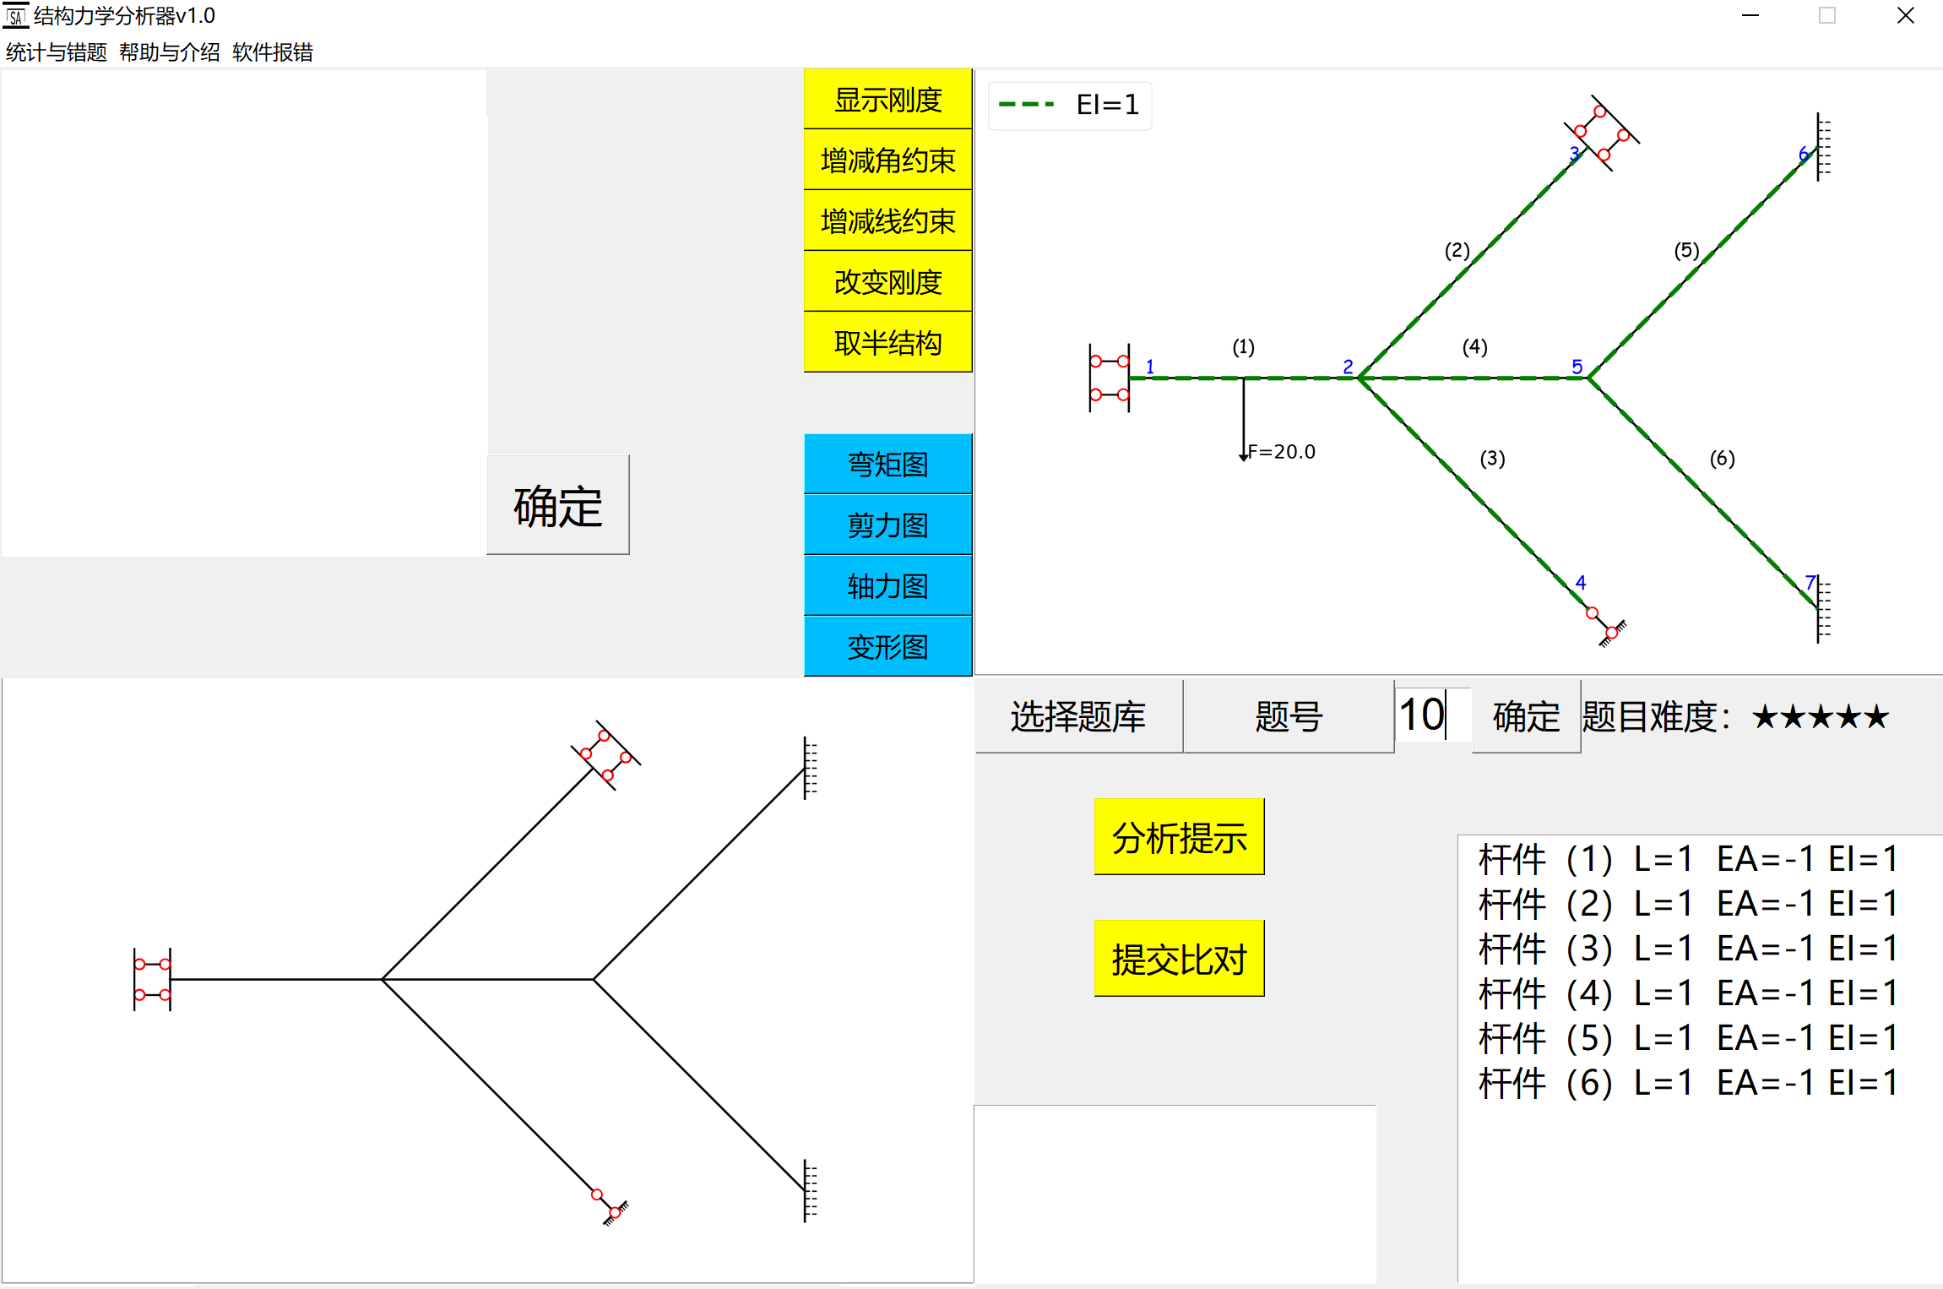

Interactive answering function
Answering area
Display area

Slide 4
Prompt tips for the whole process
Whole process
prompt tips
Click this button to get prompt tips at any time when the user is answering

Slide 5

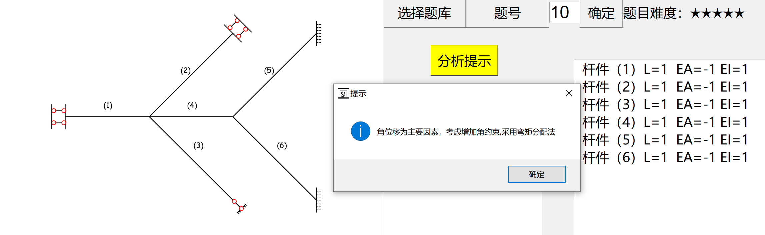
PROCRSS 1
Translation：Angular displacement is the main factor, try to add angular restraint and adopt moment distribution method

Slide 6

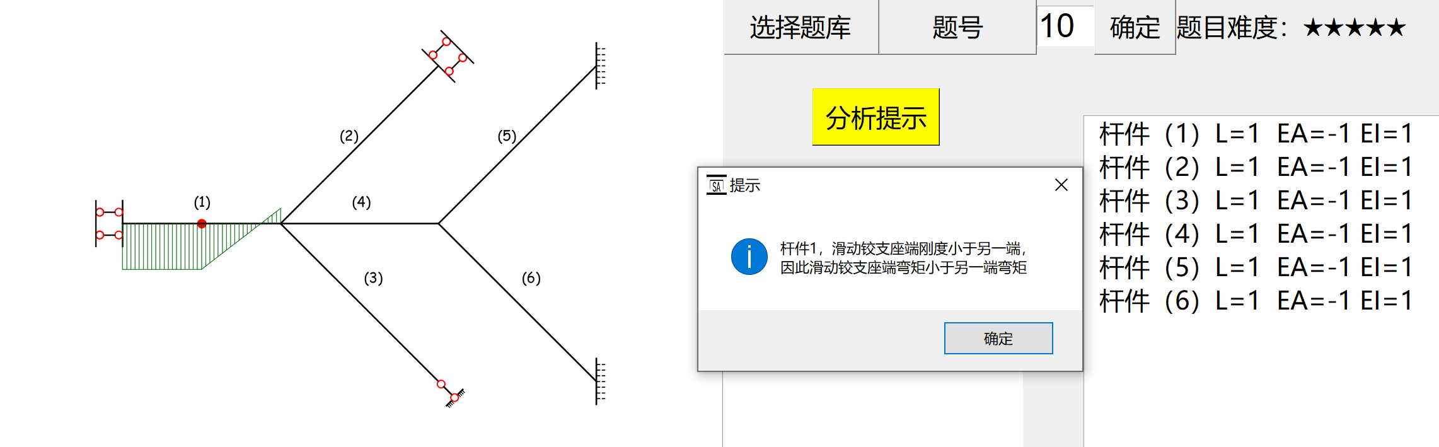
PROCRSS 2
Translation：For member one, the stiffness of the sliding hinge support is smaller than the other side, so the bending moment of the hinge support side is smaller than the other side

Slide 7
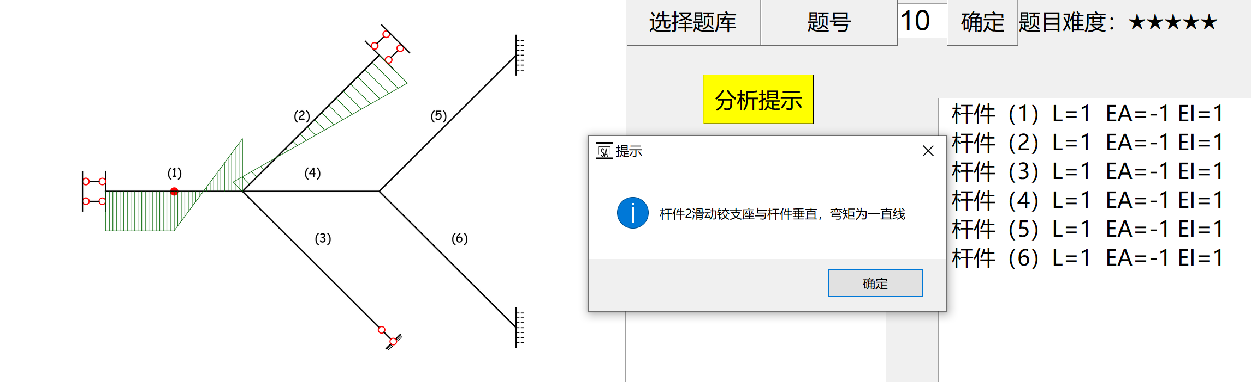
PROCRSS 3
Translation：For member two, the sliding hinge support is perpendicular to the member, so the bending moment diagram should be a line

Slide 8
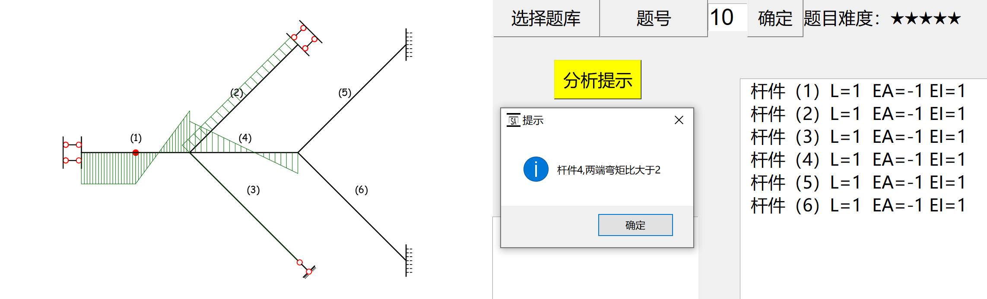
PROCRSS 4
Translation：For member four, the bending moment ratio at both ends is greater than 2

Slide 9
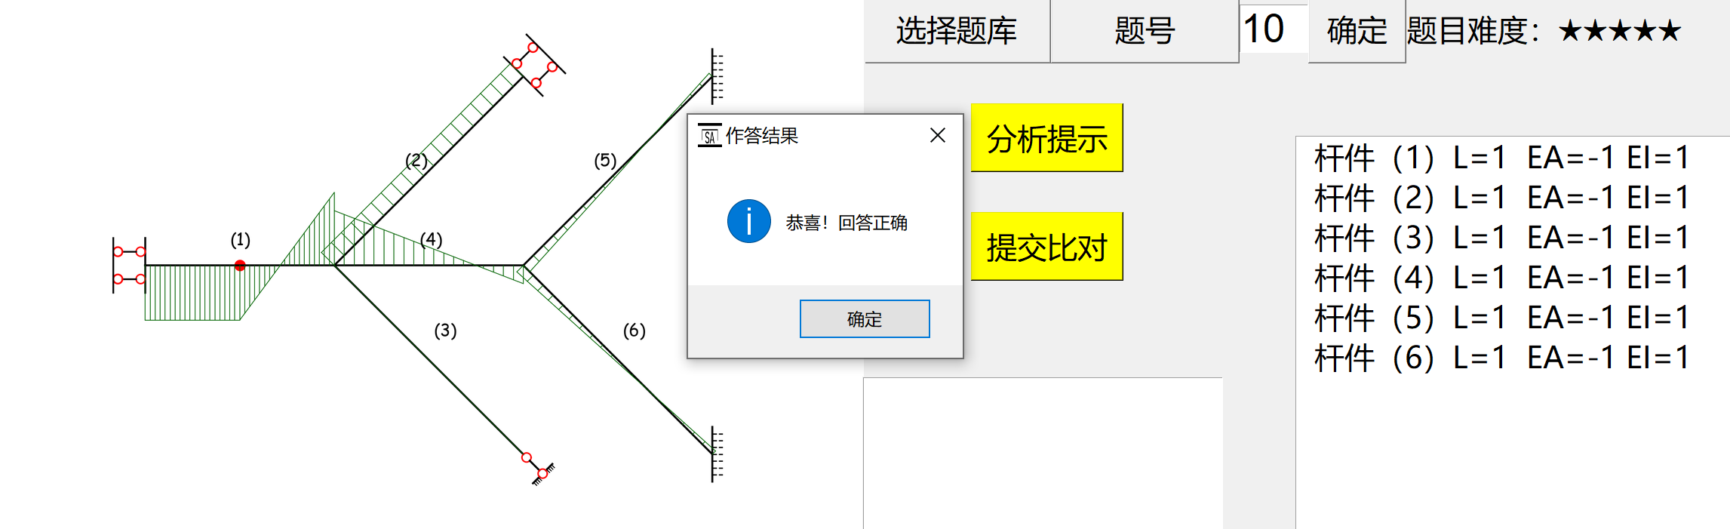
RESUlT
Translation：Congratulations! Your answer is correct

Slide 10
Shared cloud question bank
Everyone can create questions
and upload them onto the cloud question bank
to share with others

Slide 11
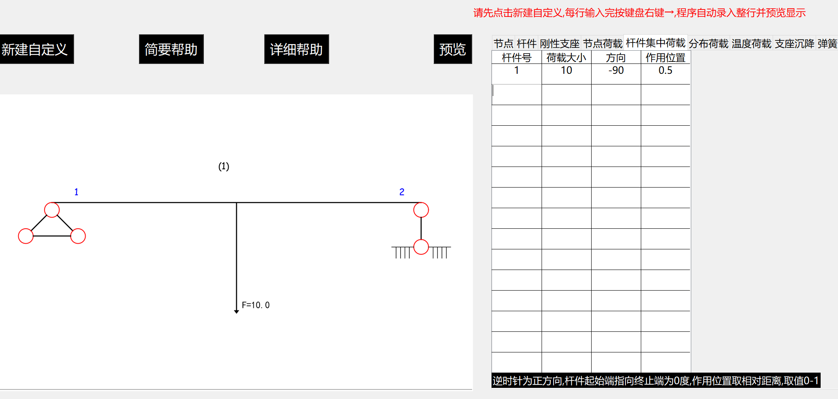
Create questions
Define questions
by
filling in the chart

Slide 12
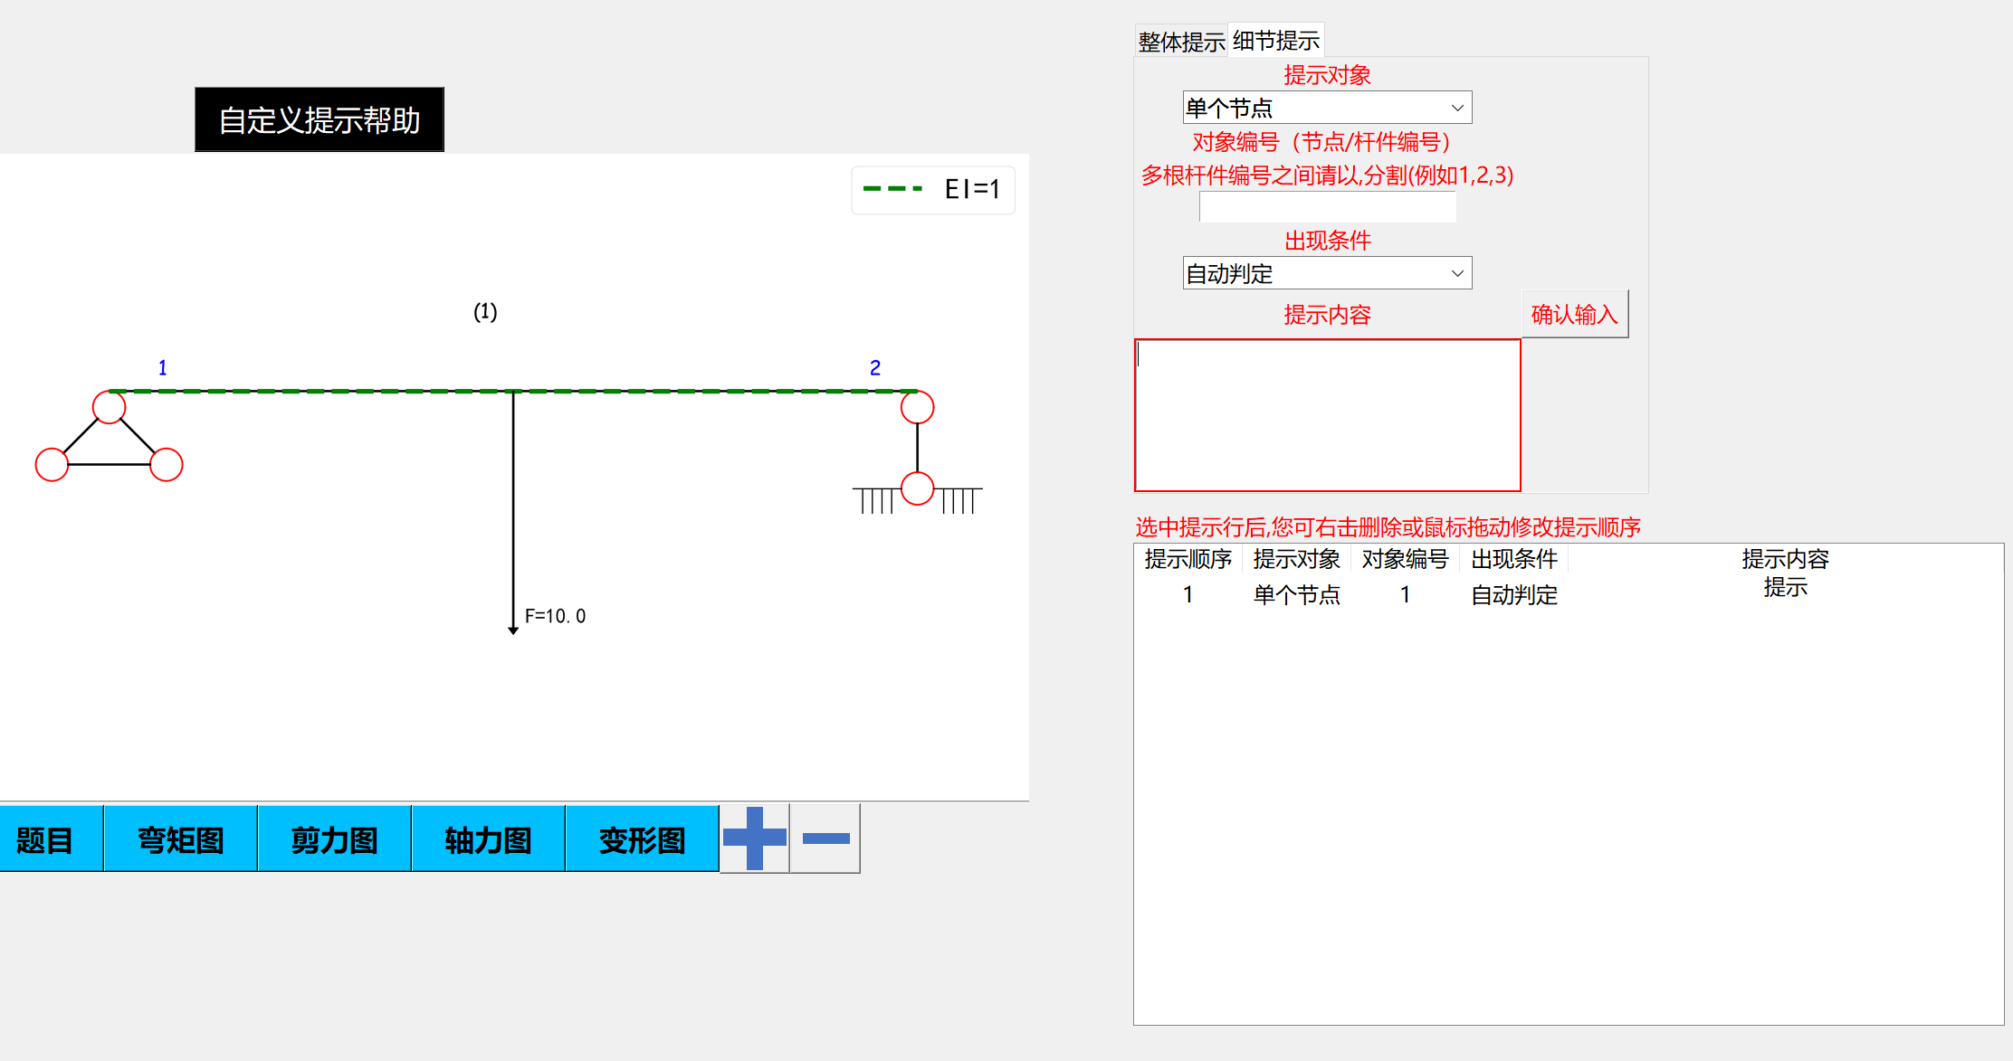
Create specific tips
Write down
your tips
for others
to solve the
problem

Slide 13
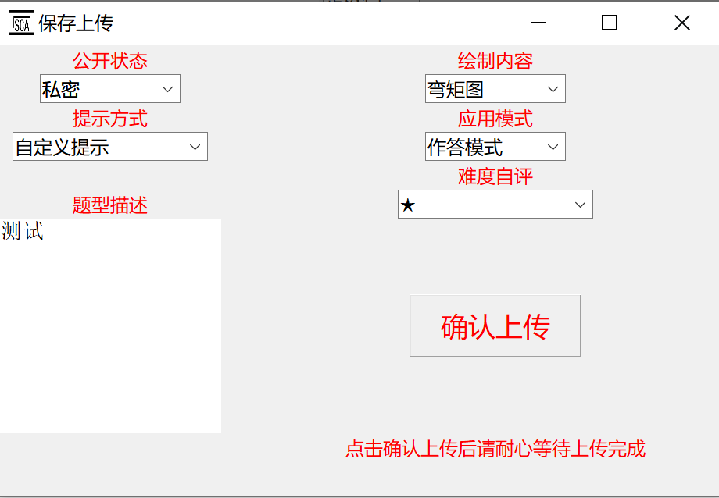
Upload the question
Upload onto the
cloud

Slide 14
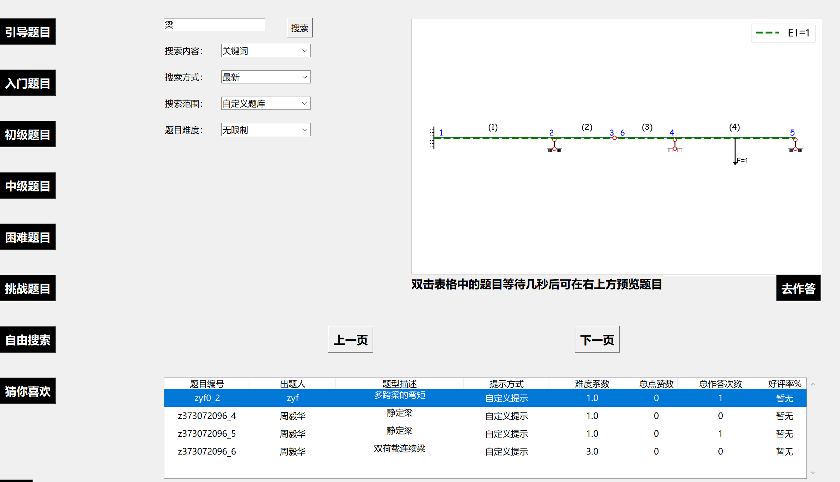
Use the shared question bank
Use the shared question bank by searching

Slide 15
Manage mode
You can review all the
questions that you have done

Slide 16
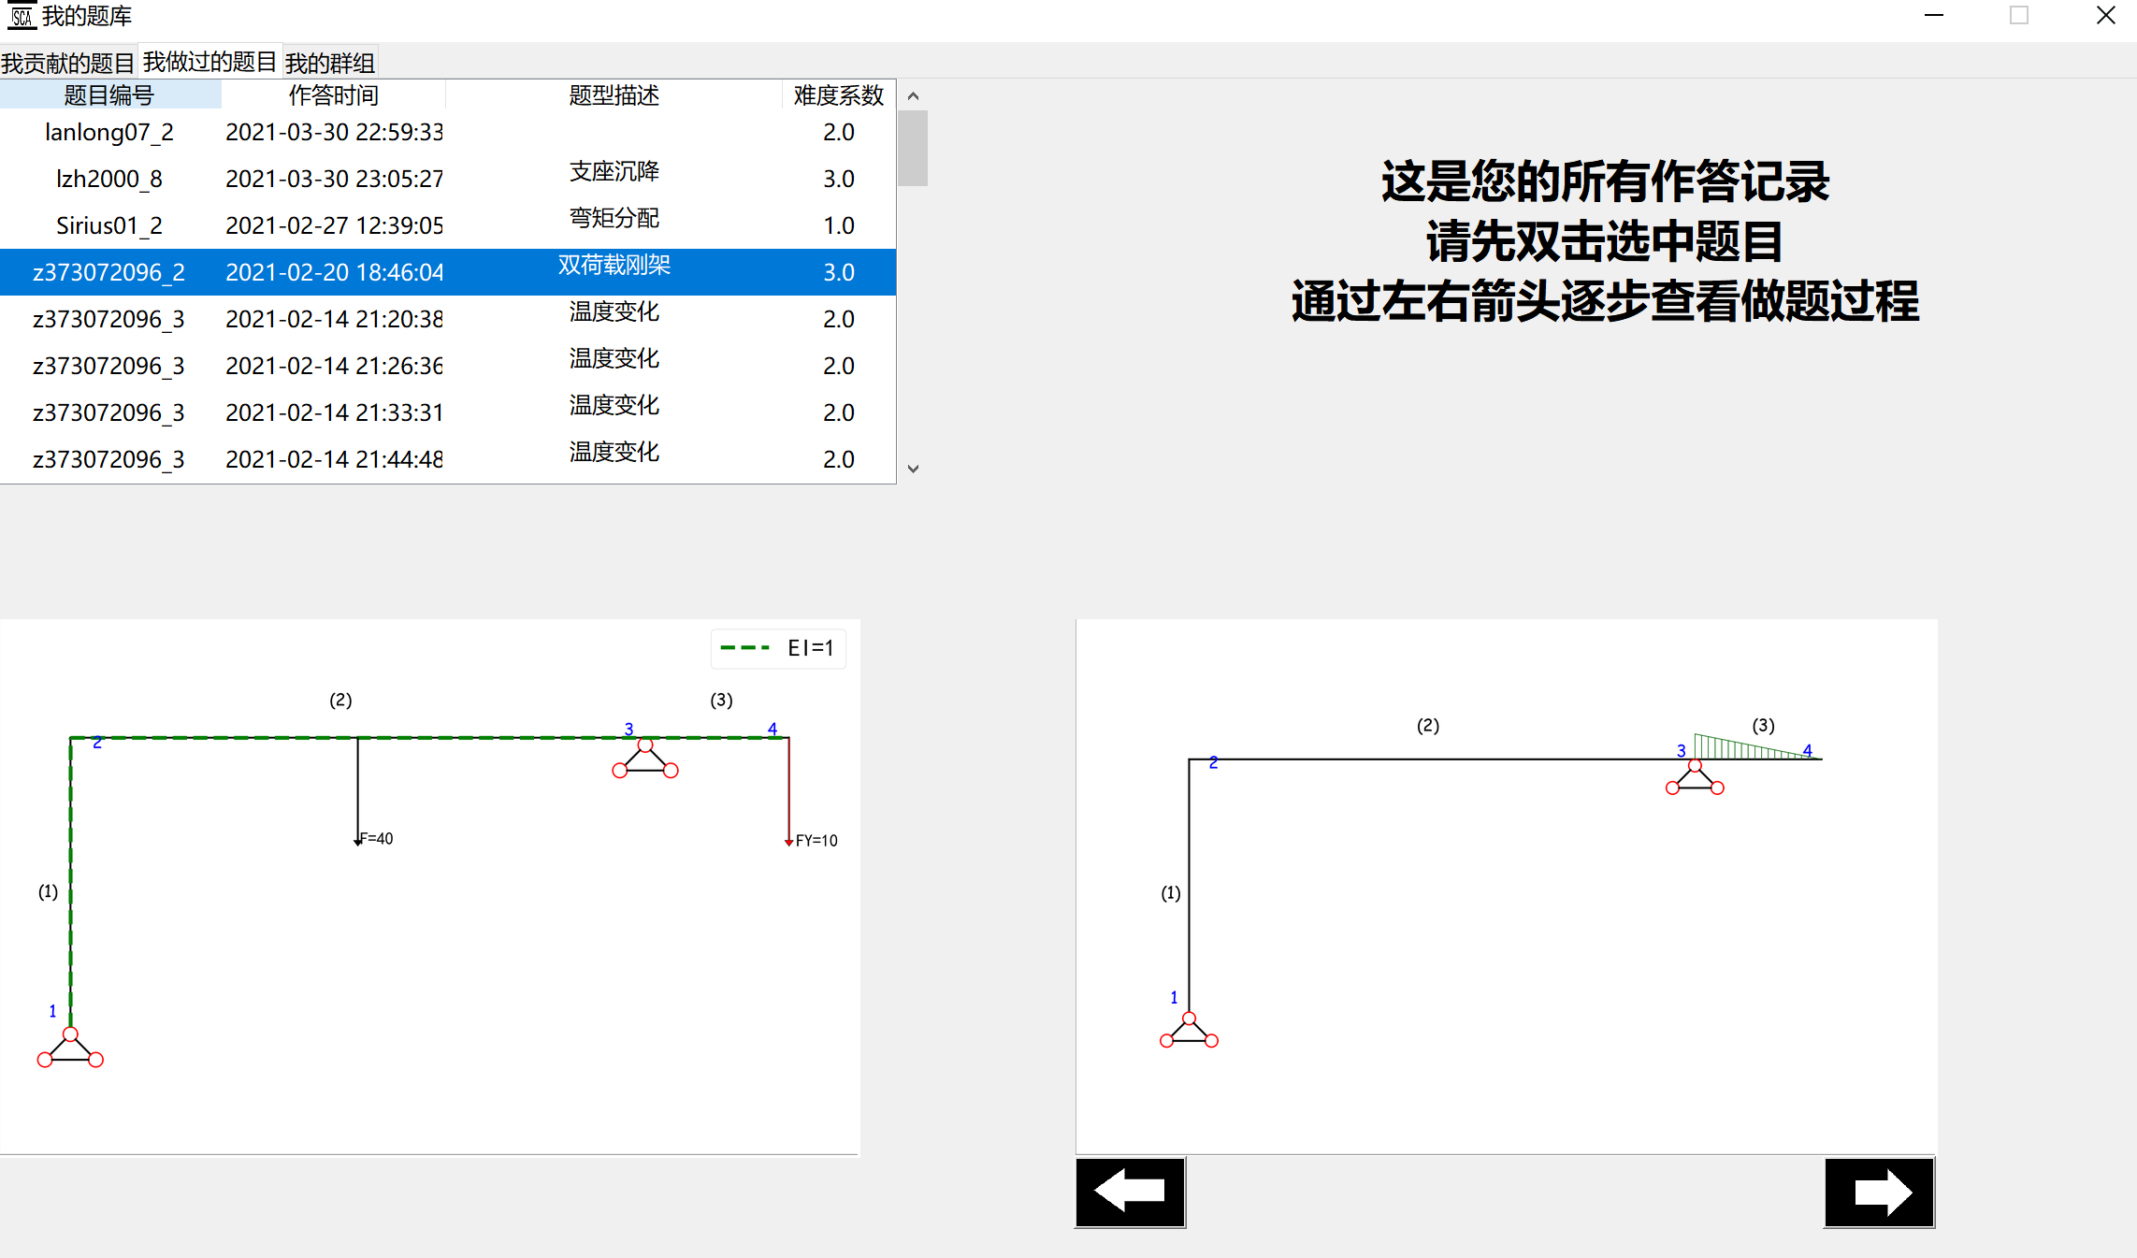
Wrong question book
Review the questions
step by step
(wrong question book)

Slide 17
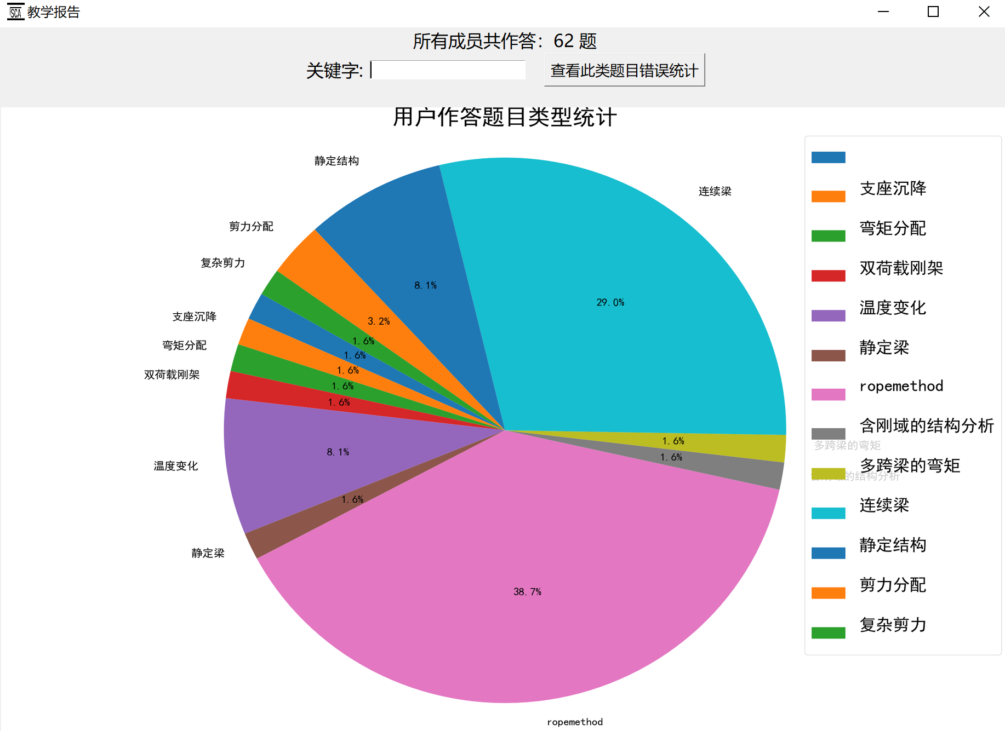
Bar chart report
Questions types
Statistics

Slide 18
Thank you for watching !

